Slide 1
CEACAM5 Target Evaluation
Confidential 1

Slide 2
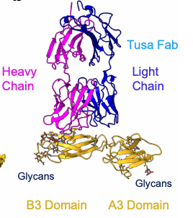
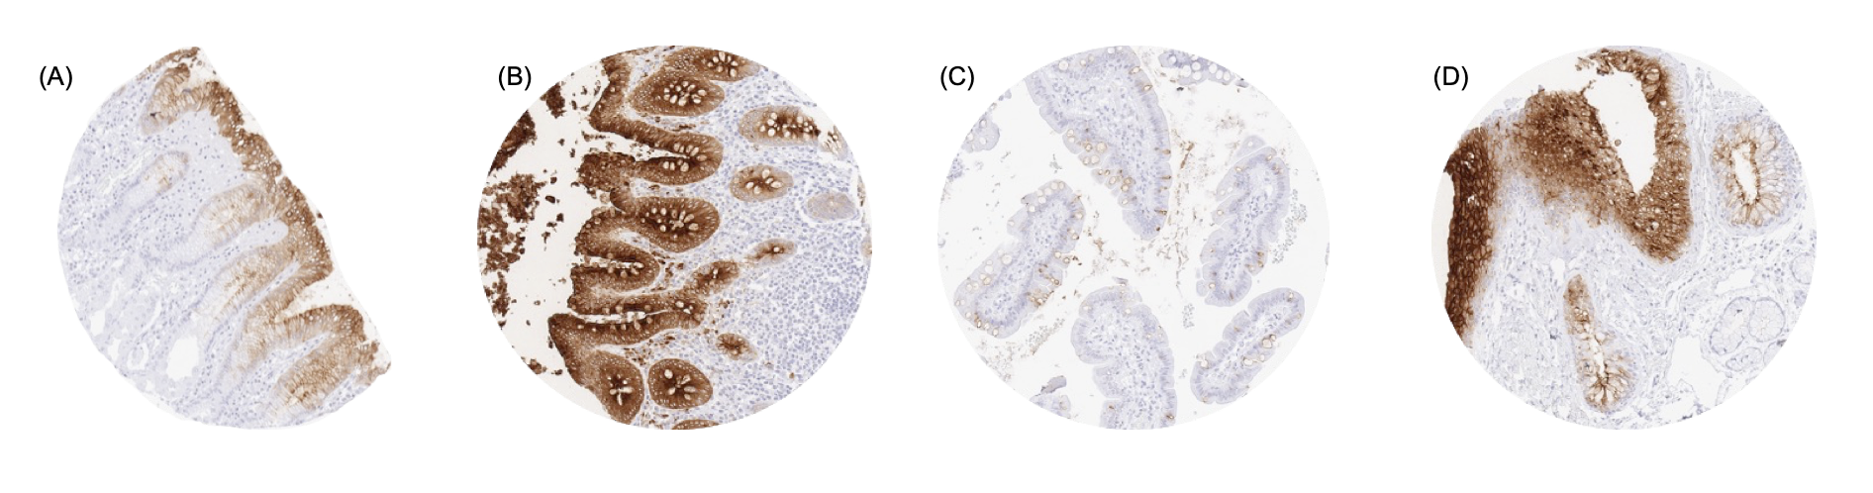
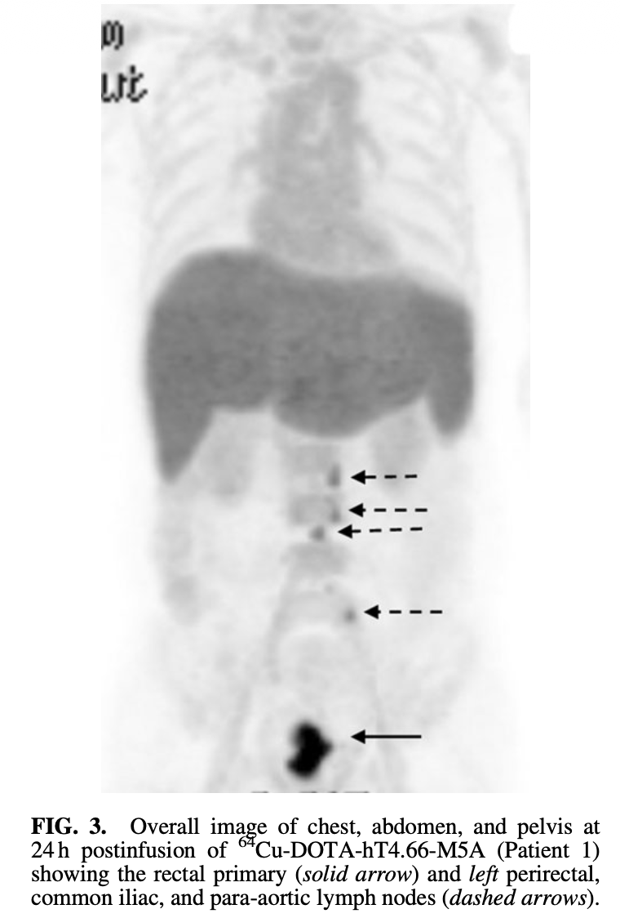
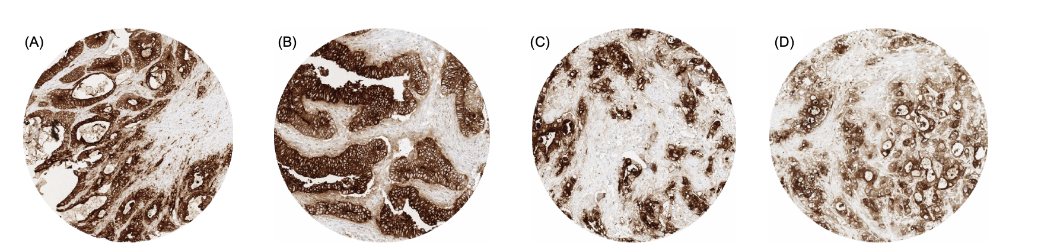
CRC: CEACAM5 accessibility is tumor-selective and validated by human imaging
Target Selection
Expression
Biology & Feasibility
CEACAM5 Immuno-PET
⁶⁴Cu-hT84.66-M5A
Tumor-specific accessibility | ✓ | Apical in normal gut, No polarization in tumors
Internalization | ~ | Slowly, inducible with mAbs, sdAbs
Secretion | ✓ | Highly abundant, no serum sink with mAb RLT observed in humans
Ligandability | ✓ | Target known A3-B3 epitope from Ab
Normal Tissues: Apical-restricted expression
Inaccessible
Clear tumor uptake of mAb RLT
Stomach
Colon
Small intestine
Respiratory
Tumors: Diffuse upregulated expression
Landscape
Metastases
Accessible
No CEACAM5 RLT in development by industry, to our knowledge
Rectal primary
Sego’s Approach
No evidence of on-target, off-tumor healthy tissue uptake. Liver uptake is due to mAb catabolism.
Modality | CEACAM5-targeted monomeric or bis-peptide RLT
Positioning | Stage II/III CRC, post surgery MRD+ patients replacing current chemo adjuvant therapy
Colon AC
Esophagus AC
PDAC
ICC
Sources: Jansen 2024 Cancers; Wong 2022 Cancer Biother Radiopharm; Wong 1997 JNM; Wong 1998 JNM; Kumar 2024 Nature Comm.

Slide 3
Landscape
CEACAM5-directed programs support targetability and provide early read-throughs for RLT development
Lead clinical ADC programs
Earlier-stage & other modalities
Key read-throughs for RLT
Tusamitamab ravtansine (Sanofi) — Ph3 terminated. 2L NSCLC; ORR ~20% in CEACAM5-high; Correlation of response to cCEA - ~42% ORR in high cCEA patients; mPFS ~5.5 mo. Used PET scan to select patients. Terminated after Ph 3 readout.
Precemtabart tocentecan (Merck KGaA) — Ph3 planned H1 2026. 2L+ CRC; 31% ORR; mPFS 6.9 mo; 66% Grade 3 TEAEs, largely neutropenia and anemia (possibly payload associated) and 76% Grade 1-2 GI AEs
SG-CEACAM5C (Seagen/Pfizer) — Status uncertain. Topo payload; multi-tumor; no results posted
EBC-129 (A*STAR) — Ph 1 in 2L+ PDAC, gastro, solid tumors
IBI3020 (Innovent) — Ph 1 ongoing; advanced solid tumors; FPI April 2025
SMP-190 (Chengdu XZiling) — IND enablement; DXd analog payload
CAR-T (academic) — IP delivery produced on-target colitis in some reports
Bispecific (Roche) — Stopped Ph 2 for lack of efficacy
M5A RIT (academic) — Ac-225, Phase I (recruiting), treatment of advanced and metastatic cancer
M5A diagnostic (Academic) — Cu-64, ImmunoPET imaging; tumor detection in locally advanced rectal cancer and medullary thyroid cancer, no major on target, off tumor signal detected
Biomarker selection works — IHC and cCEA correlate with response; RLT can use PET for patient stratification
ADC toxicity is payload-driven — radiation payload avoids ILD, ocular tox, and chemo-driven hematotoxicity
No on-target epithelial toxicity — consistent across ADCs, CAR-T, and bispecifics; apical polarity protects normal tissue
Pan-tumor potential validated — programs span CRC, NSCLC, PDAC, gastric, SCLC; mirrors RLT opportunity
No industry-led CEACAM5-directed RLT exists — Academic efforts have shown promise on target and tumor-specific labeling
Confidential 3

Slide 4
CEACAM5 Details
Confidential 4

Slide 5
CEACAM5 is an ideal target for RLT
Biology
Carcinoembryonic antigen-related cell adhesion molecule 5 (CEACAM5, CD66e, CEA) is a GPI-anchored cell-surface glycoprotein (180 kDa). It plays complex roles in cellular adhesion, signaling, and tumor progression. Slow constitutive turnover (~14.5 h). Tumors release soluble CEA into the serum (sCEA >10 ng/mL high, >20 ng/mL very high).
CEACAM5 expression in normal epithelium is restricted to the apical/luminal surfaces; apical CEACAM5 is not accessible from the blood. In tumors, apical polarity is lost and CEACAM5 is expressed across the entire cell surface making it accessible to circulating radioligands in the blood. Highly overexpressed in colorectal cancer (90-100%), other GI tumors (60-80%), medullary thyroid (>95%), lung (65-75%), and neuroendocrine prostate cancer (~58%).
CEACAM5’s targetability is shown by existing mAbs, sdAbs, and peptides, that bind a variety of epitopes in the N1 or A3-B3 domains. A crystal structure of CEACAM5 A3-B3 is available (membrane-proximal, internalization). Successful peptide selection will exclude cross-reactivity to other CEACAMs and select for internalizing binders.
CRC is the 3rd most diagnosed & 2nd leading cause of cancer-related mortality worldwide. ~25% of newly diagnosed CRC patients present with or go on to (~40%) develop metastatic disease (mCRC), of which ~85% is unresectable and incurable. There is a profound unmet need for more effective therapies. No known CEACAM5-directed RLT in industry-lead development.
Expression
Feasibility
Landscape
Sego’s Opportunity
Goal: Best-in-class peptide RLT for CRC.
Design: Achieve efficient internalization and intracellular accumulation to drive higher tumor uptake and retention, resulting in superior antitumor efficacy against a consistently, selectively, and highly overexpressed target.
Confidential 5

Slide 6
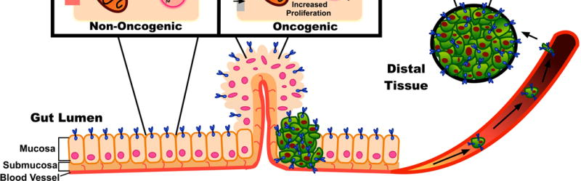
Biology
CEACAM5: Tumor-selective expression and tumor-specific accessibility
Inside the colon
When expressed in healthy colon, CEACAM5 is located on the apical side of the epithelial brush border facing the lumen (toward the inside of the colon) throughout the entire gastrointestinal tract, from duodenum to rectum, but it is not directly accessible from the blood. This separation from blood circulation minimizes the risk of on-target, off-tumor effects in healthy tissue.
During tumorigenesis, cells lose apical-basolateral polarization (i.e., it is no longer restricted to the inside of the colon), leading to CEACAM5 expression across the entire cancer cell surface. CEACAM5 on tumor cells is accessible for binding by RLT.
Apical target expression in normal epithelium => inaccessible
Target overexpression on the entire tumor cell membrane => accessible
Bloodstream
Adapted from Aka Exp Rev Clin Pharmacol 2017
Confidential 6
Notes:
Selective: high levels in tumors but minimal in most healthy tissues
Tumor-specific distribution: in tumors all over the cell, making it easily accessible, but not accessible in healthy colon, it's at the top surface/apical

Slide 7
Expression
CEACAM5 expression is highly tumor-selective and clinically validated
Staining restricted to apical membrane normal tissues
Tumor selective CEA targeting is clinically validated
Stomach
Colon
Small intestine
Respiratory
FIH Pilot PET Immunoimaging with
⁶⁴Cu-Anti-CEA hT84.66-M5A
Overall image of chest, abdomen, and pelvis at 24 h p.i. of ⁶⁴Cu-DOTA-M5A (Patient 1) showing the rectal primary (solid arrow) and left perirectal, common iliac, and para-aortic lymph nodes (dashed arrows).
Diffuse membrane staining in cancers
Colon AC
Esophagus AC
PDAC
ICC
No evidence of healthy tissue uptake in stomach, colon and lungs.
Protein dose escalation showed no impact of serum CEA on biodistribution or tumor targeting.
Sources: Jansen 2024 Cancers; Wong 2022 Cancer Biother Radiopharm; Wong 1997 JNM; Wong 1998 JNM
Confidential 7

Slide 8
Expression
CEACAM5 is consistently & frequently overexpressed in CRC and beyond
Tumor expression levels
Indication | Type | Method | Criteria | Value | Source
CRC | Protein | IHC | 3+ and 2+ | 89.4%, High intensity tissue CEACAM5 (tCEA), n=6629 | Aldilaijan 2023, Sci Rep.
 | Protein | IHC | Positive if >30% 3+ and 2+ intensity | 100% colorectal adenomas, 98.7% carcinomas | Jansen 2024 Cancers
 | mRNA | RNASeq | Median pTPM > 25 | Rectum AC (2923), Colon AC (2651) | Human Protein Atlas
MTC | Protein |  | Positive if >30% 3+ and 2+ intensity | >96.3% | Jansen 2024 Cancers
PDAC | Protein | IHC | Positive if ≥20% of cells at 2+ or 3+ intensity | 60%, n=553 | Jansen 2024 Cancers
NEPC | Protein | IHC | H-Score Range | Median 60, range 0-200; in AR-/NE+, n=72, significantly higher than AR+/NE- | Ajkunic 2024 NPJ Precis Oncol.
 | Protein | IHC | H-score | Higher in NEPC (H-score 81) compared to other prostate cancer subtypes | DeLucia 2021 Clin Cancer Res.
Healthy tissue expression
 | Type | Method | Criteria | Value | Source
All | Protein | IHC | HPA Medium or High | Limited expression, restricted to the apical portion of the cell; high in GI tract and squamous epithelia, most abundant in the large intestine | Human Protein Atlas
All | mRNA | RNAseq | nPTM>10 | High in colon (385), none in kidney (0) | Human Protein Atlas
Confidential 8

Slide 9
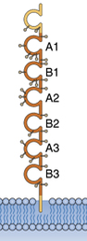
Biology
Biology of CEACAM5 is amenable to RLT
Cell surface accessible in tumors
Internalized by membrane-proximal binding
sCEA does not impact RLT biodistribution
A heavily glycosylated cell surface glycoprotein.
Functions as a cell adhesion molecule, facilitating cell-cell binding. Involved in differentiation, maintenance of cell polarity, prevention of apoptosis (anoikis), and associated with cancer stem cells.
Cell surface location:
Normal tissues: low expression in the GI tract and squamous epithelia; apical surface = not accessible to RLT
Cancer tissues: depolarized overexpression across the entire cell surface = accessible to peptide RLT
CEACAM5 is constitutively internalized at a slow rate (10-16 h). Internalization is accelerated in a binder-dependent manner; it is increased by cross-linking or membrane-proximal binding (A3-B3 domain).
The relationship between binding epitope and internalization is worth further exploration, as is the rate of internalization & recycling.
Serum CEA (sCEA) Quantities: normal <3 ng/mL; high >10 ng/mL, very high >20 ng/mL, suggesting progression/metastasis. sCEA surges after chemotherapy (2-7 weeks).
Serum half-life: 3-7 days; rapid fall after effective treatment; longer half-life or increase suggests recurrence/progression. sCEA is metabolized in the liver, which is less radiosensitive and larger volume than kidneys.
A clinical trial with ⁹⁰Y-anti-CEA mAb showed no significant changes in tumor uptake, PK or biodistribution with protein dose escalation (5 -105 mg). From this data, the potential impact of sCEA acting as an antigen sink on PK and effectiveness of RPT seems negligible.
CEA Structure
Known antibody binding site on membrane proximal A3-B3 domains serve as target for peptide binding development
Sources: Kim 2009 Acta Oncol.; Cong 2025 EJNMMI, Nessler 2024 Mol Cancer Ther, Schmidt 2008 CancerImmunolImmunother., Wong 2022 Cancer Biother Radiopharm
Confidential 9

Slide 10
Landscape
CEACAM5 positivity is consistently high across all stages of CRC and increases with disease progression, driving clinical opportunities for treatment of advanced CRC
~154,000 new cases and ~53,000 deaths from colorectal cancer in the US in 2025
Stage II/III post-resection, MRD+ patients
Late line mCRC
(≥3L)
Approach | Adjuvant, curative intent monotherapy for post-resection Stage II/III, MRD+ (ctDNA+) patients | Late line monotherapy in Stage IV patients at end of treatment options
Annual incident cases | 154,000 | 154,000
% diagnosed at Stage | 70-80% local/regional | 20% distant
 | ~90% undergo surgery | 25-30% advance to 3rd line
 | ~15% MRD+
% CEACAM Positive | ~90-100% | ~90-100%
Rough estimate TAM: | 14,000 | 7,300
Sources: SEER , Siegel Cancer Journal for Clinicians 2023, Tarpgaard Cancers (Basel) 2023, Abidoye MDPi 2025, Nakamura Nature Med 2024, Upadhyay Ther Adv Med Oncol 2015, Liu Ther Adv Gastero 2022
Confidential 10

Slide 11
Landscape
Example Target Product Profile for CEACAM5-RLT in MRD+, post-resection CRC
Mechanism / Mode of Action | CEACAM5-targeted peptide ligand conjugated to chelated ²²⁵Ac, delivering targeted alpha radiation to eradicate microscopic residual disease.
Clinical Trial Design | Randomized Phase III. CEACAM5-RLT vs. standard adjuvant chemotherapy (CAPOX/FOLFOX) with curative intent.
Indication / Target Patients | Post-resection Stage II (high risk) or Stage III CRC patients who are MRD+ (ctDNA+) as measured 4-8 weeks post-op and prior to receiving adjuvant chemotherapy.
Dosing Regimen & Administration | Intravenous infusion of CEACAM5-RLT for 4 doses, 4 weeks apart, and 2 doses every six months following the initial cycle until progression
Clinical Endpoints | Primary Endpoints: Disease Free Survival (DFS) at 18 or 24 months Secondary & Exploratory Endpoints: mDFS, ctDNA clearance, durability of ctDNA response, overall survival, etc.
Efficacy |  | CEACAM5-RLT | Adjuvant Chemo (CAPOX/FOLFOX)
 | Dosing Schedule | See above | 3-6 mo of standard regimen
 | DFS (18 mo) | >80% | 62%
 | mDFS | >18 mo | 12 mo
 | ctDNA clearance (>18 mo) | >60% | 37% (“sustained clearance”)
 | ctDNA clearance (6 mo) | >75% | 68%
Safety / Tolerability | Grade ≥3 TEAEs Neuropathy risk | <30% Minimal/none | 50-60% 17-48%
Sources: Nakamura Nature Med 2024, Kotani Nature Med 2023, Grothey NEJM 2018
Confidential 11

Slide 12
Opportunity
Sego’s approach to developing a CEACAM5 peptide RLT
 | Sego’s Approach
 | Cyclic peptide targeting the membrane-proximal domains of CEACAM5 | Bis-CEACAM5 Approach
Modality | Cyclic peptide targeted to the A3-B3 domains of CEACAM5 on the surface of tumor cells | Peptide dimer (2x peptides for CEACAM5)
Isotope/Payload | ²²⁵Ac or ¹⁶¹Tb | ²²⁵Ac or ¹⁶¹Tb
Internalization | Select for internalizing peptides by targeting the A3-B3 domain or for peptides that bind CEACAM5 close to the cell surface with high affinity and low Koff. | Cross-linking of CEACAM5 receptors on the cell surface increases internalization rate. Bivalent binding increases binding to membrane CEA (high density on cell surface) vs soluble CEA in serum.
Advantage | CEACAM5 is selectively blood-accessible in primary and metastatic CRC but not in healthy tissue, providing a large therapeutic window. | Improved K_{D} and tumor uptake/retention due to bis-peptide design, hypothetical better efficacy and potential lower doses required. May allow for use of lower affinity monomeric peptide.
Confidential 12

